Slide 1
IBM Data Science Professional Certificate
Applied Data Science Capstone
Presented by: Pouyan Khakbaz

Slide 2
Introduction and Data
Diabetes is one of major concerns in public health
Pima Indian database from UCI repository was selected
8 features were identified in the original file and they were attributed to the diabetes
There are 768 total observations in the pima database
All 8 features were used to build our model

Slide 3
Methodology
We are dealing with categorical problem
Yes or No problem to predict the chance for Diabetes
We used classification models to predict the outcome
K-nearest neighbor (KNN)
Support vector machine (SVM)
Decision trees

Slide 4
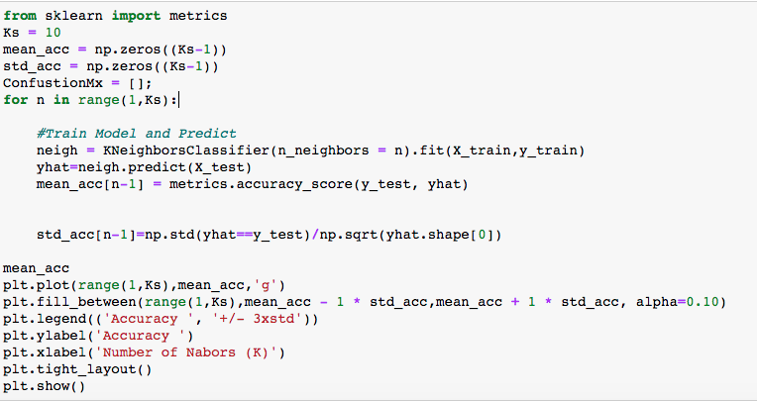
Results
K-nearest neighbors (KNN)

Slide 5
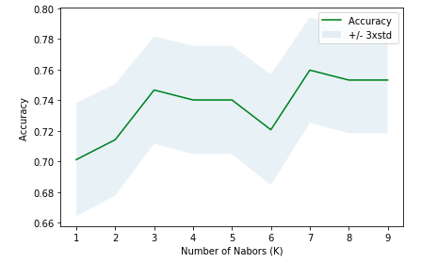
Results
The result indicated 7 as the best value to build KNN classification model

Slide 6
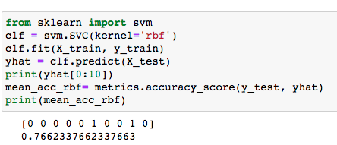
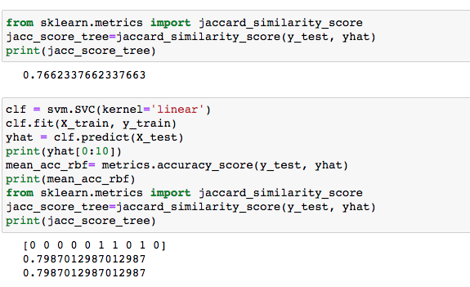
Results: SVM
SVM resulted in higher accuracy compared to KNN

Slide 7
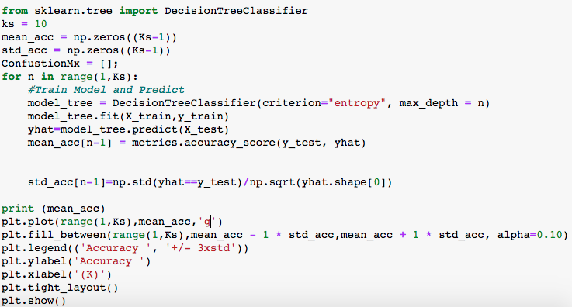
Results: Decision Trees

Slide 8
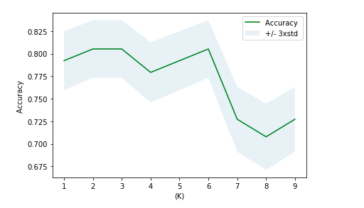
Results: Decision Trees
K=3 resulted in highest accuracy compared to all other methods

Slide 9
Conclusions
Machine learning classification methods were able to predict the chance of Diabetes for patients
K nearest neighbors (KNN), Support vector machine (SVM) and Decision trees classifies were investigated
Decision trees machine learning algorithm with K=3 resulted in the best accuracy compared to all other classification techniques.

